Slide 1
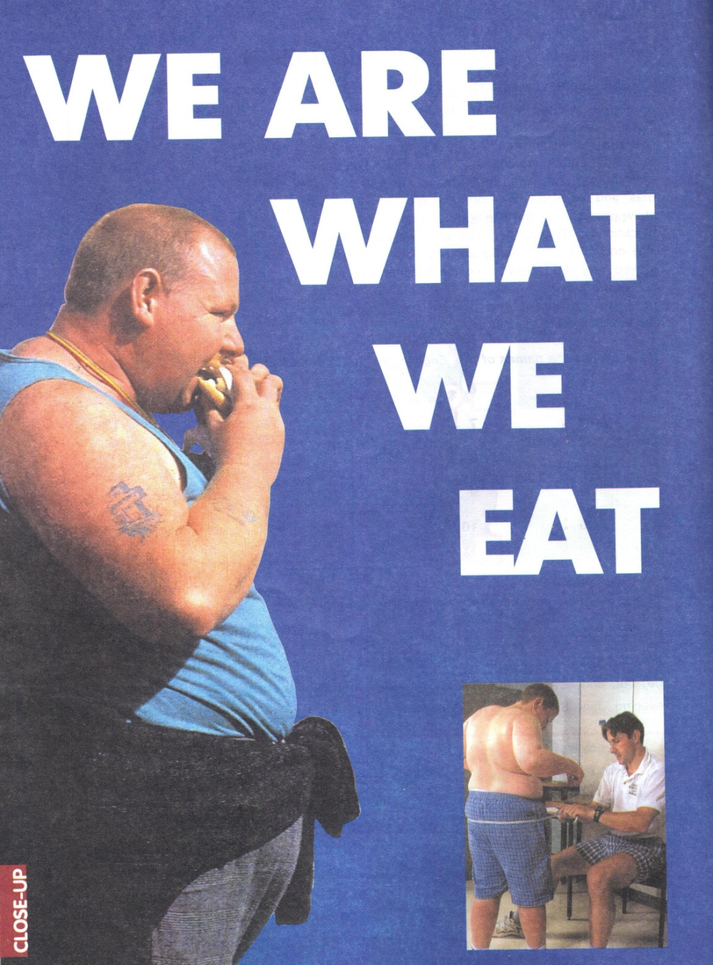

Slide 2
Proverbs: * Good health is above wealth. * Eat to live, not live to eat * An apple a day keeps the doctor away

Slide 3
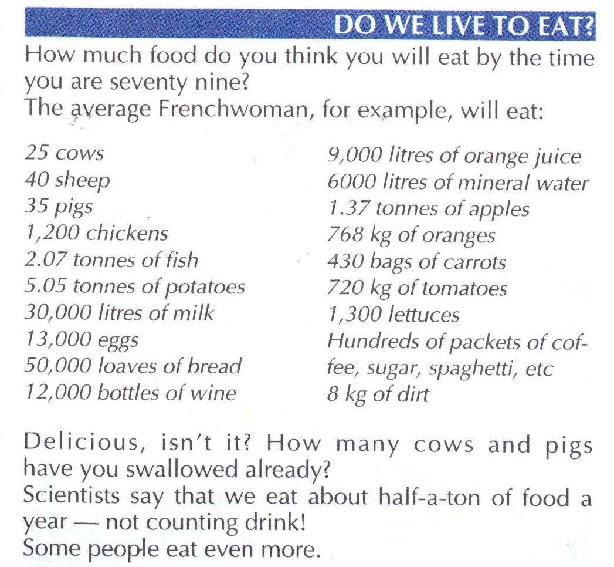

Slide 4
Five basic types of food a person should eat

Slide 5
Meat helps you have a strong and healthy body by providing protein

Slide 6
Dairy builds strong teeth and bones by providing calcium

Slide 7
Fruits/Vegetables help you have healthy gums, good eyesight etc. by providing Vitamins A and C.

Slide 8
Bread/cereal Gives you energy by providing protein, iron, and several B vitamines

Slide 9
Fats/Sugars Fast sources of energy

Slide 10
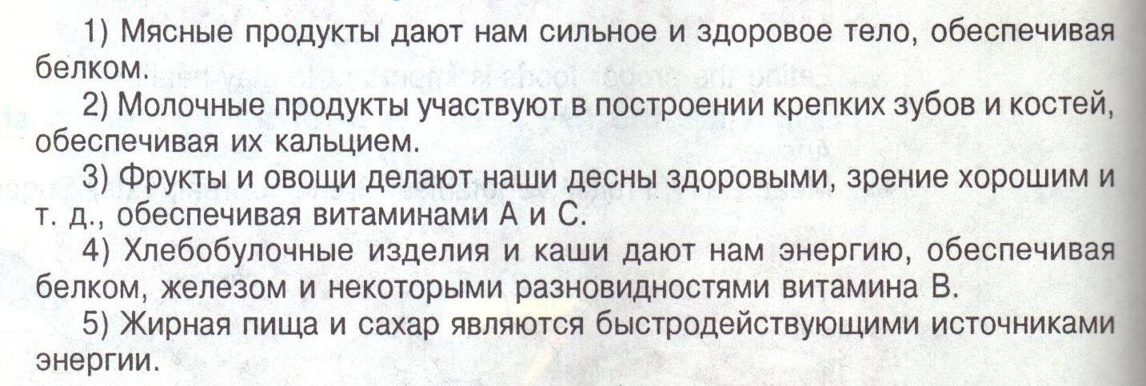
Translate:

Slide 11
Which girl is eating a better lunch? Why is it better?

Slide 12
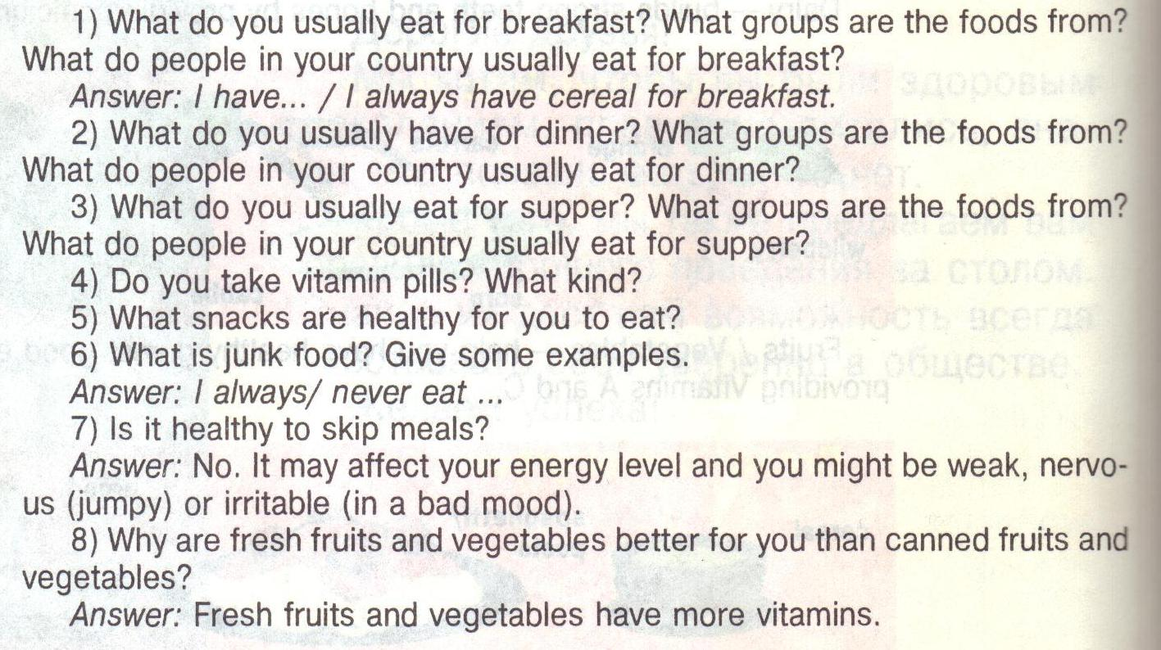
Answer the questions:

Slide 13
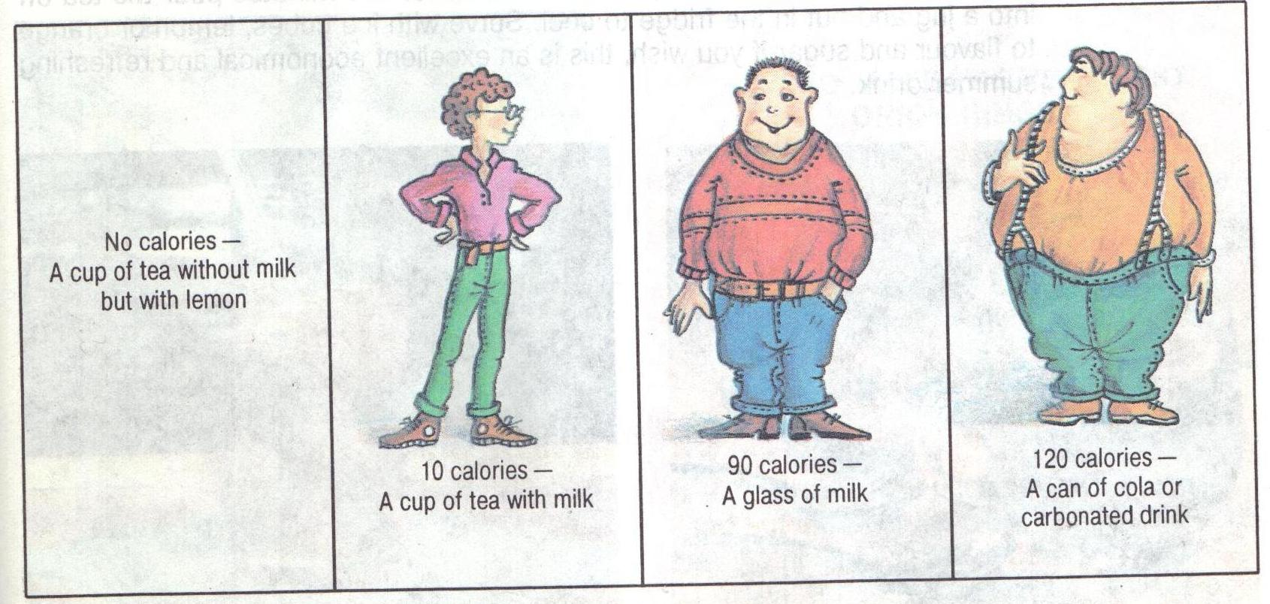
Compare the calories:

Slide 14
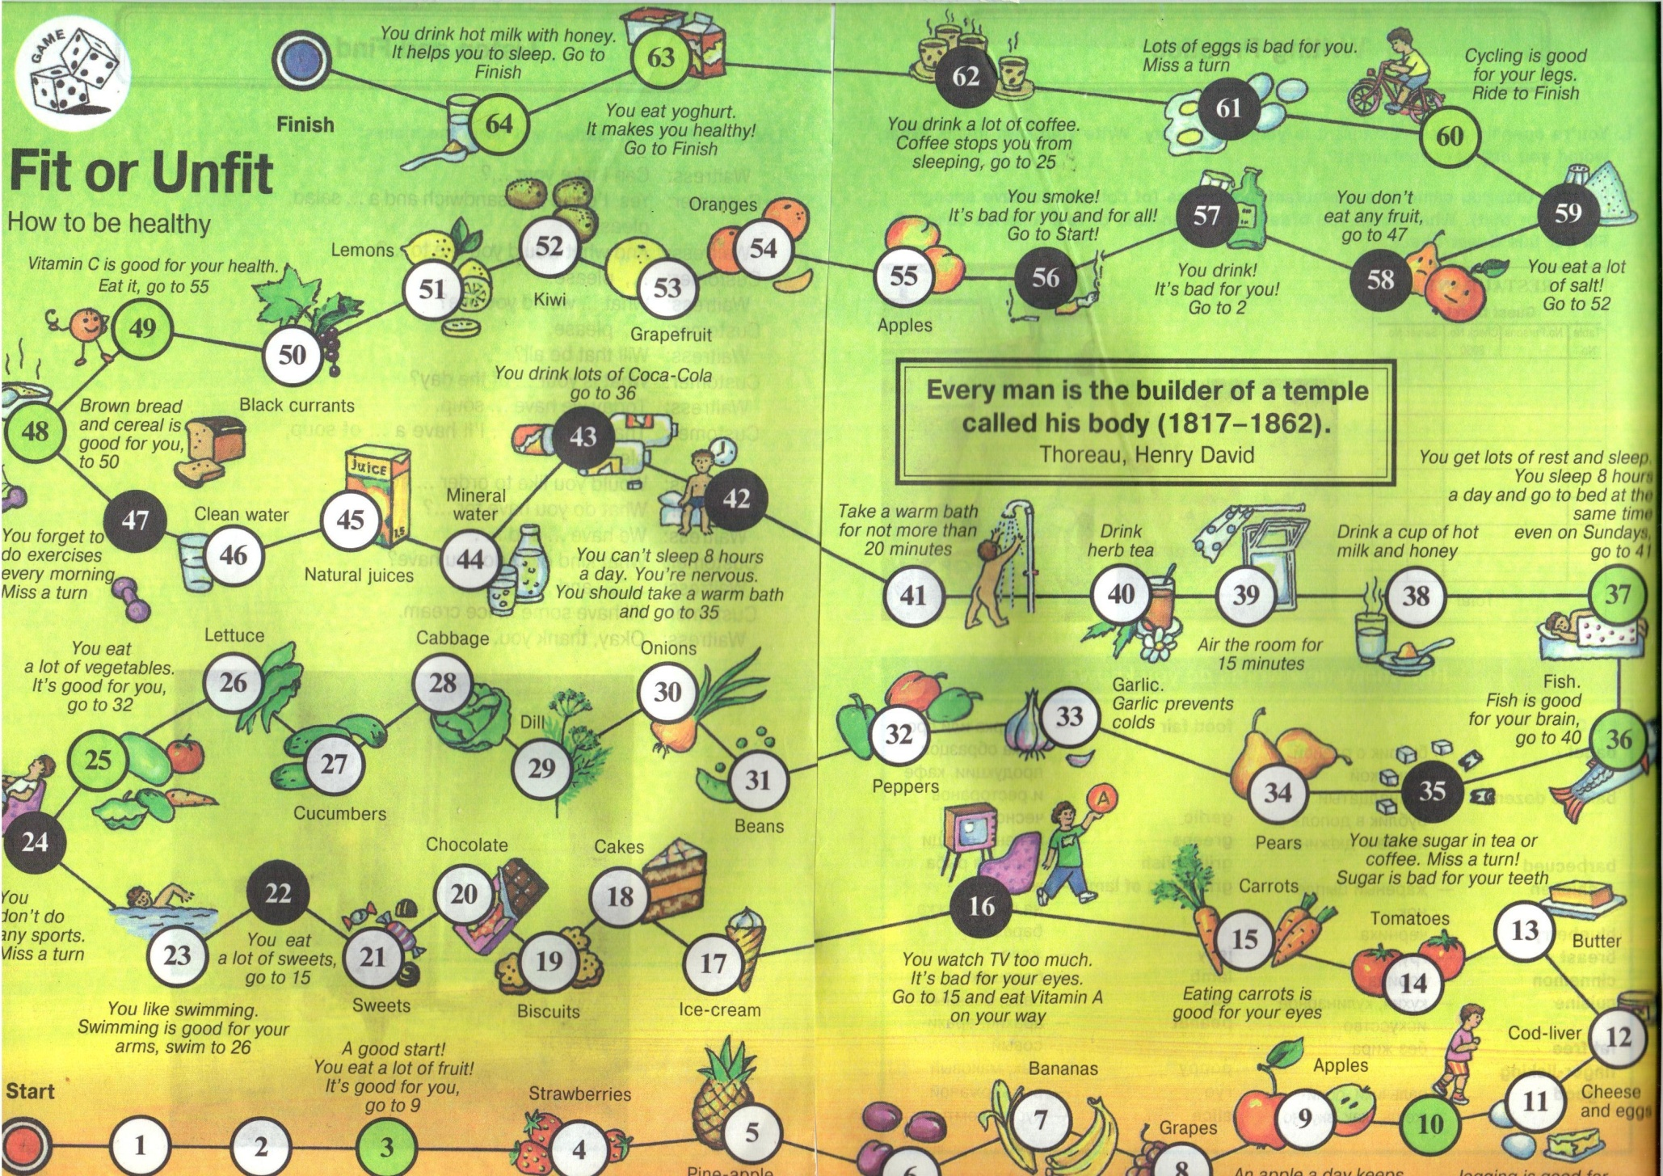
Play a game:

